Slide 1
IMO example question

Slide 2
Question:
称坐标平面上的一条直线为阳光的,如果它与x-轴、y-轴和直线z+y=0均不平行.给定整数n≥3.求所有非负整数k,使得存在平面上两两不同的n条直线满足下面两个条件:
1.对所有满足a+b ≤ n+1的正整数a和6,这n条直线中至少有一条经过点(a,b)
2.这n条直线中恰有k条是阳光的
Question: Call a line in the Cartesian plane sunny if it is not parallel to the x-axis, the y-axis, or the line x+y=0. Given an integer n≥3, determine all non-negative integers k for which there exist n distinct lines in the plane satisfying the following two conditions
1.For every pair of positive integers (a, b) with a + b ≤ n + 1, at least one of the n lines passes through the point (a, b).
2.Exactly k of the n lines are sunny.

Slide 3
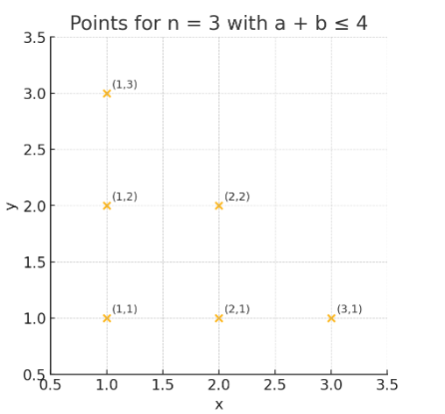
Question Solving
Condition 1
While we have n straight lines, a + b ≤ n + 1, and n ≥ 3.
Assume n = 3 as example, for every pair of positive integers will be (1,1), (1,2), (1,3), (2,1), (2,2), (3,1)， and these n lines have to cover all these
points. Therefore, this question’s essential is asking how many
different tpyes of ways, make n lines cover all points while k
is the number of sunshine lines in n lines.

Slide 4
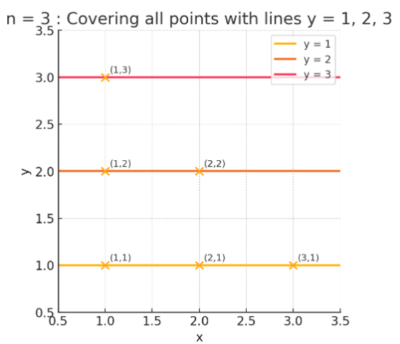
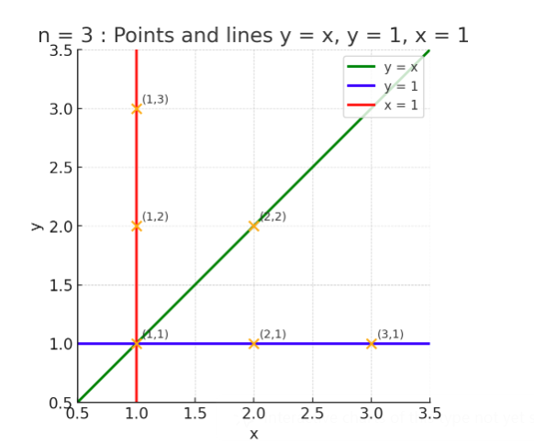
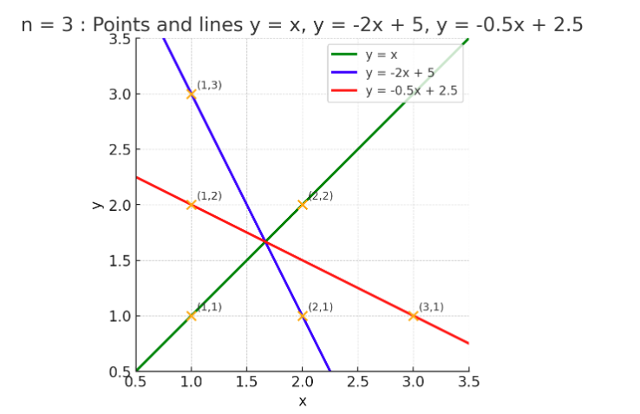
Question Solving
Sunshine line is line who do not parallel to the x-axis, the y-axis, or the line x+y=0. And there will be k = 0, 1, 3 possible. And this is only for n = 3 example.

Slide 5
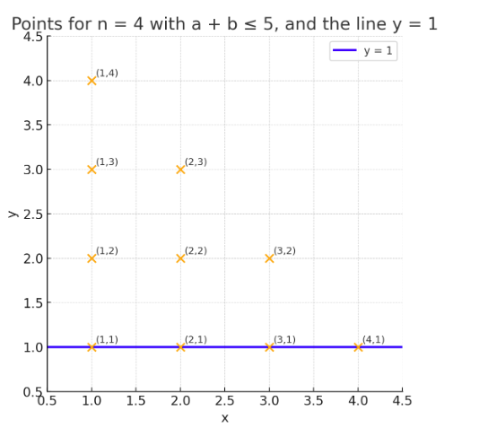
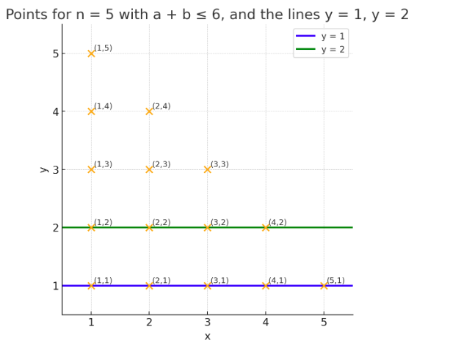
Question Solving
Next, we need to expand the question from only example of n = 3 to all the positive integer. While we add n to 4, we may add a line at y = 1 to cover 4 points, and we still have 3 lines left to cover the points left, and n = 4 is tranfer to the example n = 3. For all n after, we add another line of y = n - 3, and the 3 k will stand for all integer n.

Slide 6
Question Solving
Infeasibility – ruling out k = 2 and larger values
Contradiction from the “outer‑shell” lattice points
Along the three boundary lines x = 1, y = 1, x + y = n + 1 there are exactly 3(n − 1) lattice points.
If none of these boundary segments coincides entirely with one of the n lines, each line can pass through at most two boundary points.
• For n > 3 we have 3(n − 1) > 2n; hence some boundary points would be left uncovered, a contradiction.
• Therefore at least one non‑sunny line must coincide with a boundary side.
The remaining n − 1 lines reduce to the same problem with size n − 1 and can contain only 0, 1, or 3 sunny lines.
Altogether we still obtain k ∈ {0, 1, 3}.

Slide 7
Question Solving
Excluding k = 2 (illustrated for n = 3, extendable to larger n)
Assume two sunny lines together with one non‑sunny line cover all six points for n = 3.
A case analysis—whether each sunny line passes through 0, 1, or 2 points—forces the single non‑sunny line to go through at least four points simultaneously.
Direct verification shows this is impossible, hence k ≠ 2.
Larger values of k
For n ≥ 4, if we suppose k ≥ 4 then at most two non‑sunny lines remain.
Using the upper bound that each sunny line passes through at most ⌊(n − 2)/2⌋ lattice points inside Tₙ, one can show that two non‑sunny lines cannot compensate for the points left uncovered; the covering therefore fails. (Full inductive proof)

Slide 8
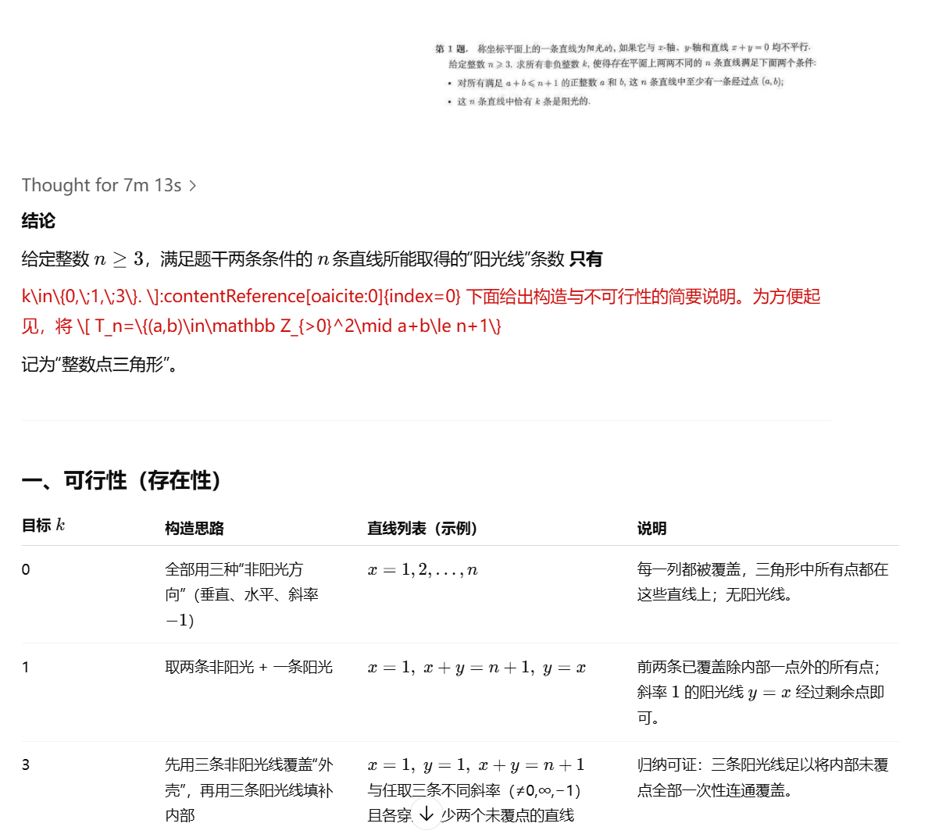
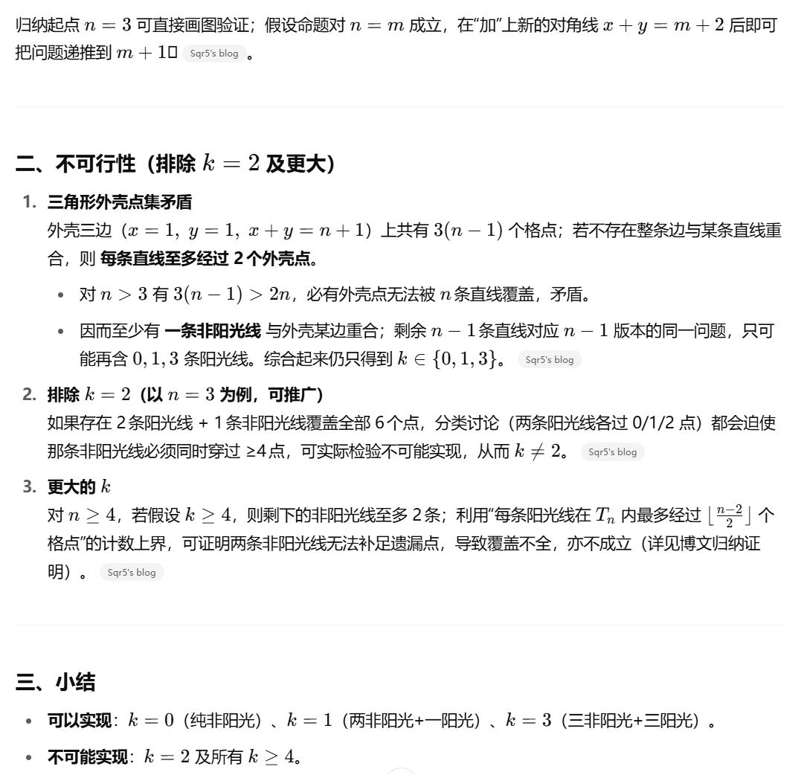
Model response

